Slide 1
Recommending Enriched Nutrition Diet Using Predictive Analytics
Guided By
Mr.K.Vignesh.
CSE Department.

Slide 2
PS No: FS-PS 43 Team no : FS-63
NAME | REGISTER NUMBER
BUSIREDDY HARSHITHA | 99210041929
NARA HARSHA VARDHAN | 9210041247
POLISETTY HARSHA VARDHAN | 99210041105
RAVURI HARSHA VARDHAN | 99210041731
VINJAMURI HARSHA | 99210041301

Slide 3
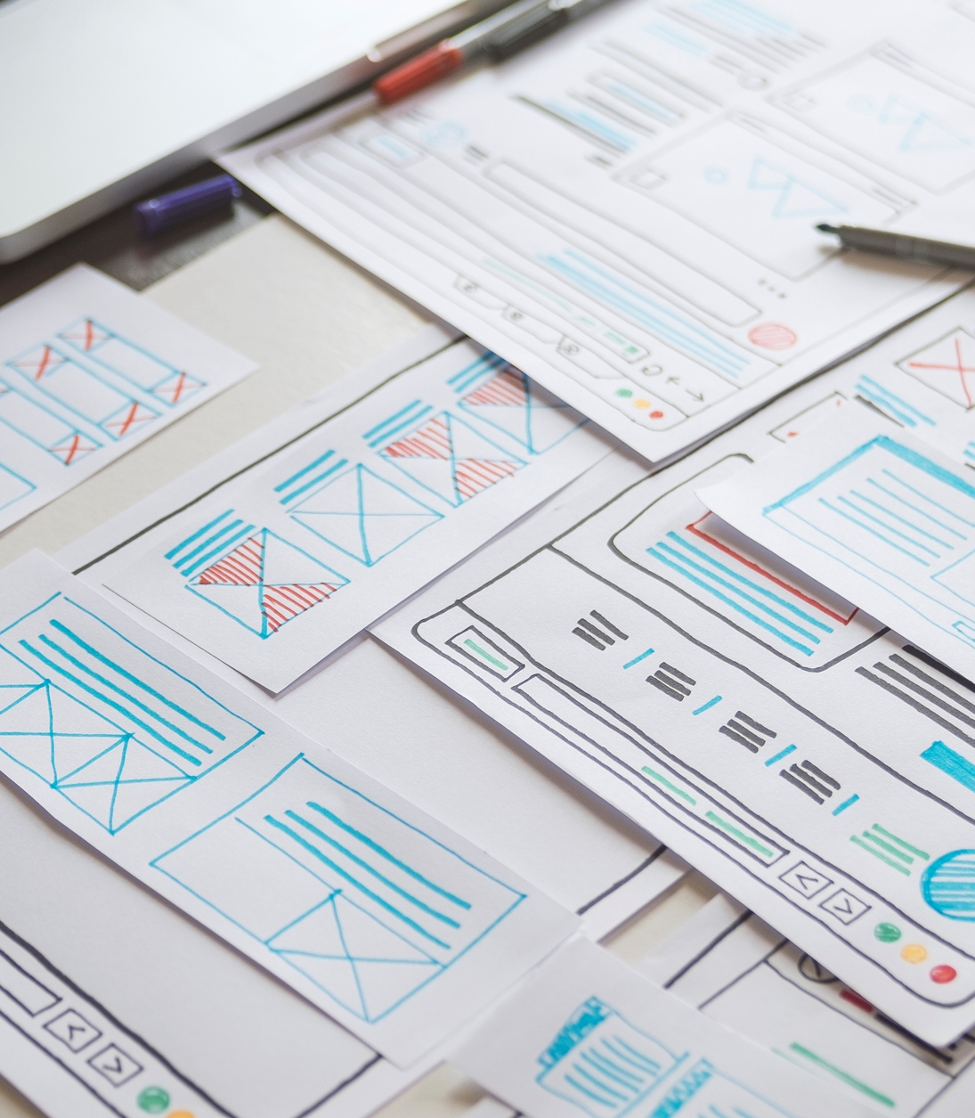
The challenge lies in creating machine learning algorithms that can prescribe a diet and analyze many factors such as body composition, activity level, and dietary preferences to create individualized nutrition plans for each user. To evaluate the recommended system diet by using some metrices and methodologies.
Problem Statement

Slide 4
ABSTRACT
Dietary Guidance: Provides tailored calorie recommendations based on individual parameters such as age, weight, and height, catering to goals like weight maintenance, loss, or gain.
Personalized Recipe or Food Suggestions: Offers food and recipe suggestions aligned with specified caloric and nutrient requirements.

Slide 5
INTRODUCTION
Recommending Enriched Nutrition Diet Using Predictive Analytics is a crucial step towards improving global health.
Malnutrition and unhealthy diets are leading causes of morbidity and mortality worldwide, with an estimated 3.4 million deaths annually.
Unhealthy diets contribute to the development of chronic diseases such as obesity, diabetes, cardiovascular disease, and certain types of cance

Slide 6
LITERATURE SURVEY
Personalized Nutrition
A study by Zeevi et al. (2015) demonstrated that personalized nutrition recommendations based on genetic data and machine learning algorithms can improve glucose control and reduce postprandial glucose responses.
Predictive Analytics in Nutrition
A study by Chen et al. (2019) developed a predictive model using machine learning algorithms to estimate daily energy needs and macronutrient distribution based on individual characteristics and activity levels.

Slide 7
LITERATURE SURVEY
Machine Learning in Nutrition
A study by Rasmussen et al. (2019) used machine learning algorithms to predict nutrient intake and identify patterns of nutrient deficiencies in a large cohort of adults.
Dietary Recommendation Systems
A study by Kim et al. (2019) developed a dietary recommendation system using machine learning algorithms to provide personalized nutrition recommendations based on individual characteristics and preferences.

Slide 8
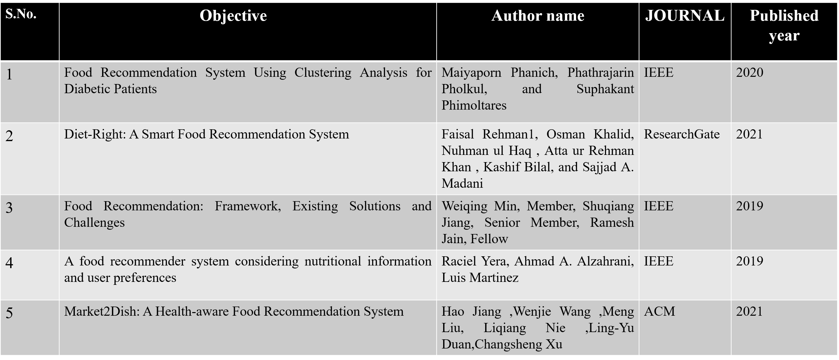
LITERATURE SURVEY

Slide 9
PROPOSED METHODOLOGY
User Input Collection
The user provides input data, including age, weight, height, and other relevant information.
Data Preprocessing
The collected data is preprocessed to ensure consistency and accuracy. This step may involve handling missing values, data normalization, and feature scaling.

Slide 10
Filtering Algorithm
A filtering algorithm is applied to the preprocessed data to generate a list of recommended diets. The filtering algorithm can be based on various factors, such as nutritional values, dietary restrictions, and user preferences.
Diet Recommendation
The filtered list of diets is then ranked based on their nutritional values and relevance to the user's input data. The top-ranked diets are recommended to the user.

Slide 11
REQUIREMENTS
User Input: Demographic information (age, gender, height, weight, etc.)
Dietary preferences (vegetarian, non Vegetarian.)
Health goals (weight loss, muscle gain, etc.)
Medical conditions (diabetes, hypertension, etc.)
Nutrition Data:
Comprehensive database of foods and their nutritional content Macronutrient and micronutrient data for each food item

Slide 12
REQUIREMENTS
Predictive Analytics:
Machine learning algorithms to predict daily caloric needs and macronutrient distribution
Ability to analyze user input and nutrition data to provide personalized recommendations
User Interface:
User-friendly interface for inputting user data and viewing recommendations
Ability to track progress and adjust recommendations based on user feedback

Slide 13
DESIGN ARCHITECTURE
Frontend:
User interface built using HTML, CSS, and JavaScript
Responsive design for mobile and desktop devices
Backend:
Server-side logic built using Python ,Flask
Integration with machine learning libraries
API connectivity for data storage and retrieval

Slide 14
Machine Learning Model
Data Preprocessing:
Cleaning and preprocessing of user input and nutrition data
Feature engineering to extract relevant features from user data.
Model Training:
Training of machine learning models using user data and nutrition information
Hyperparameter tuning for optimal model performance.
Model Deployment:
Deployment of trained models in the backend for real-time prediction
Integration with API for seamless data exchange.

Slide 15
What Our Model Can Do :
Our food suggestion algorithm takes environmental implications into account in addition to your nutritional needs. We customize your plan using machine learning to your height, weight, and medical conditions, making sure it is sustainable and healthful.
We assess the water and carbon footprint impacts of food on the environment. Our diet regimens maximize individual health and sustainability thanks to this dual approach.
Innovation:
Make use of machine learning methods to develop a customized nutrition recommendation system, such as decision trees, random forests, or deep learning models. The best dietary plan will be produced by the model using user input, taking into account individual needs and objectives.

Slide 16
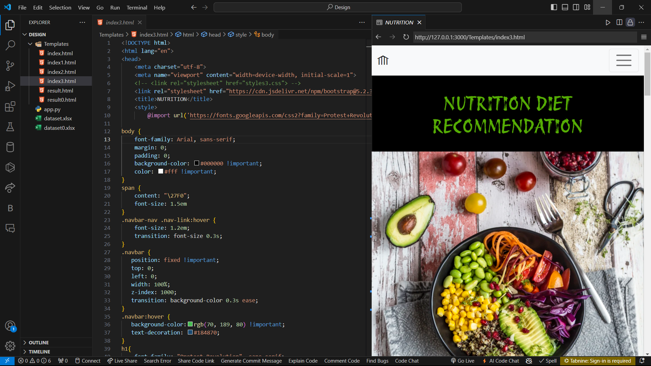
IMPLEMENTATION

Slide 17
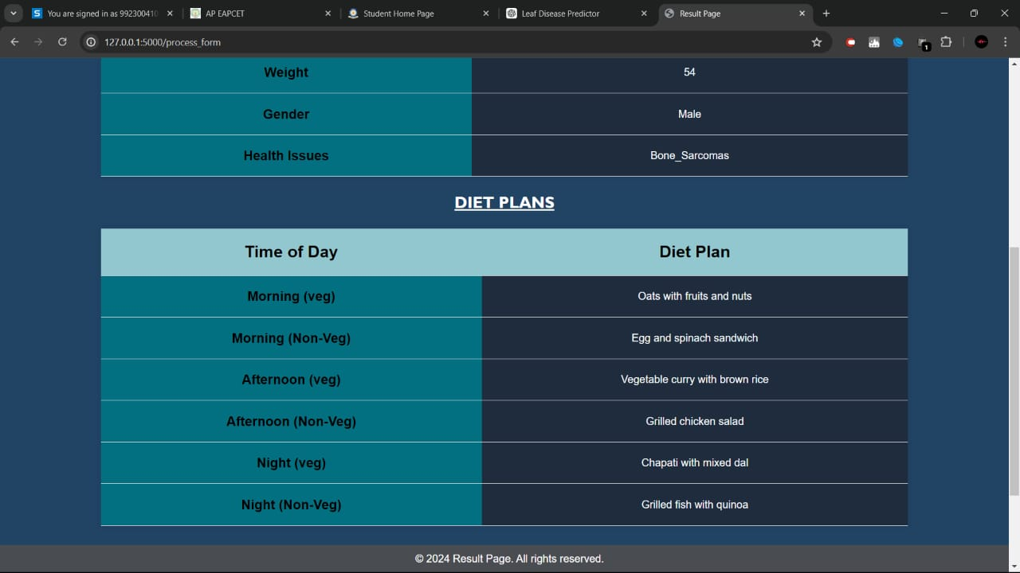
RESULTS

Slide 18
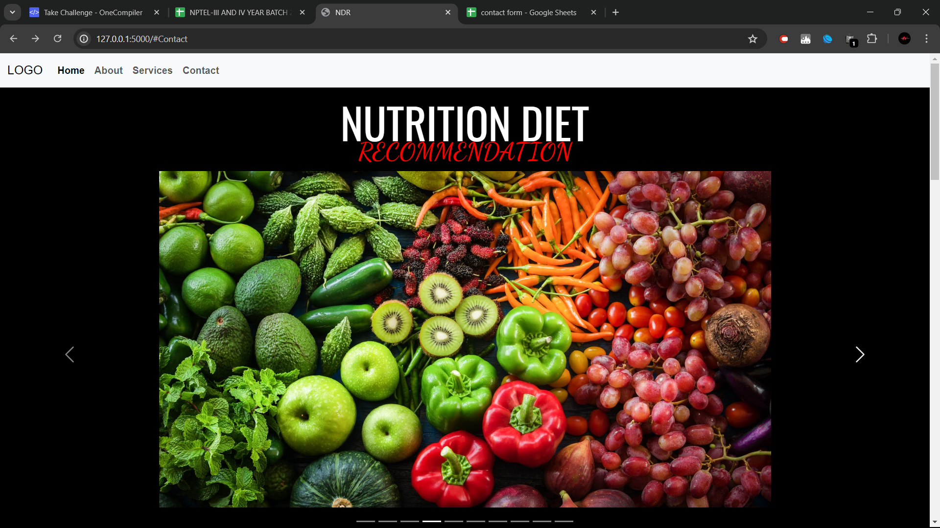
USER INTERFACE

Slide 19
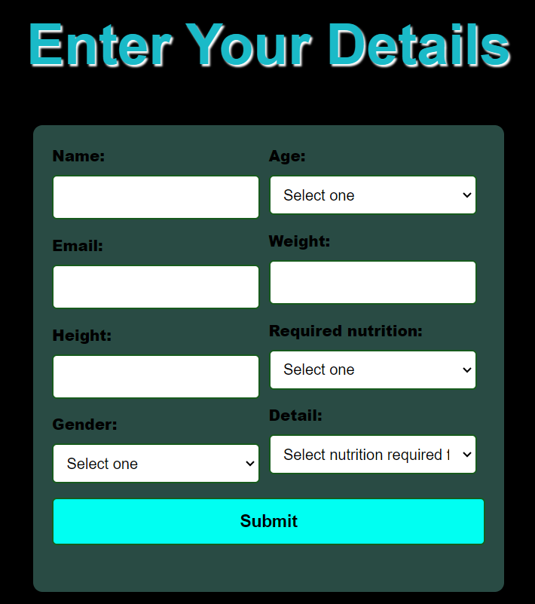
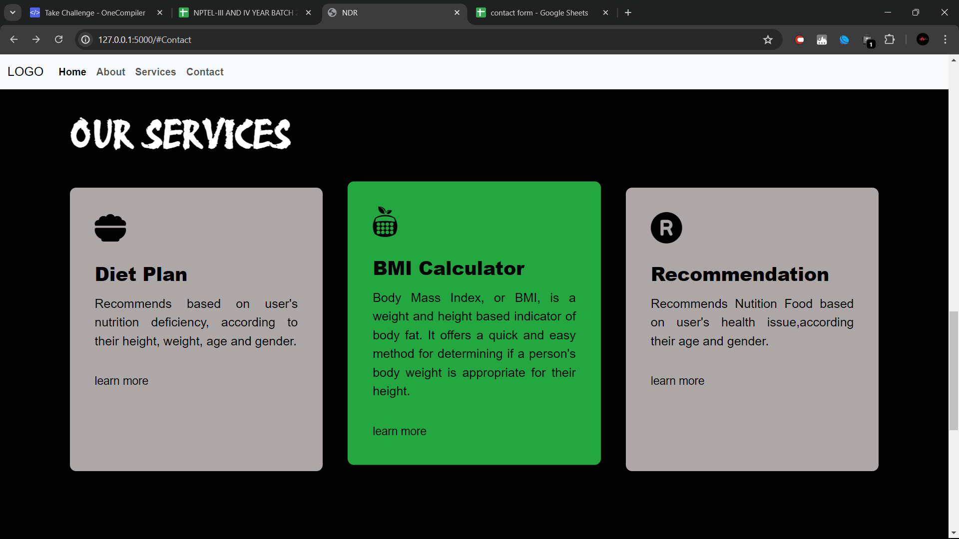

Slide 20
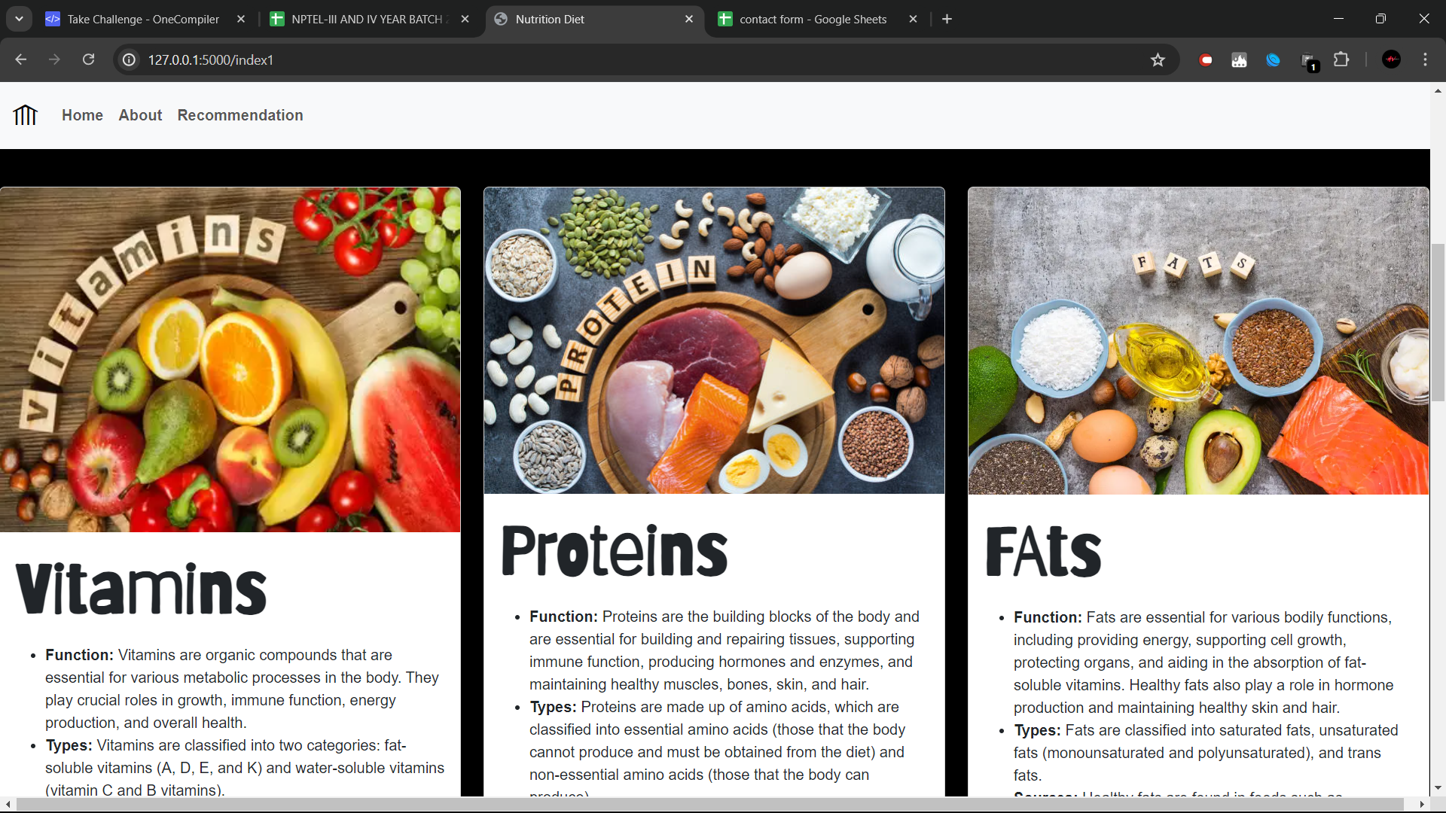

Slide 21
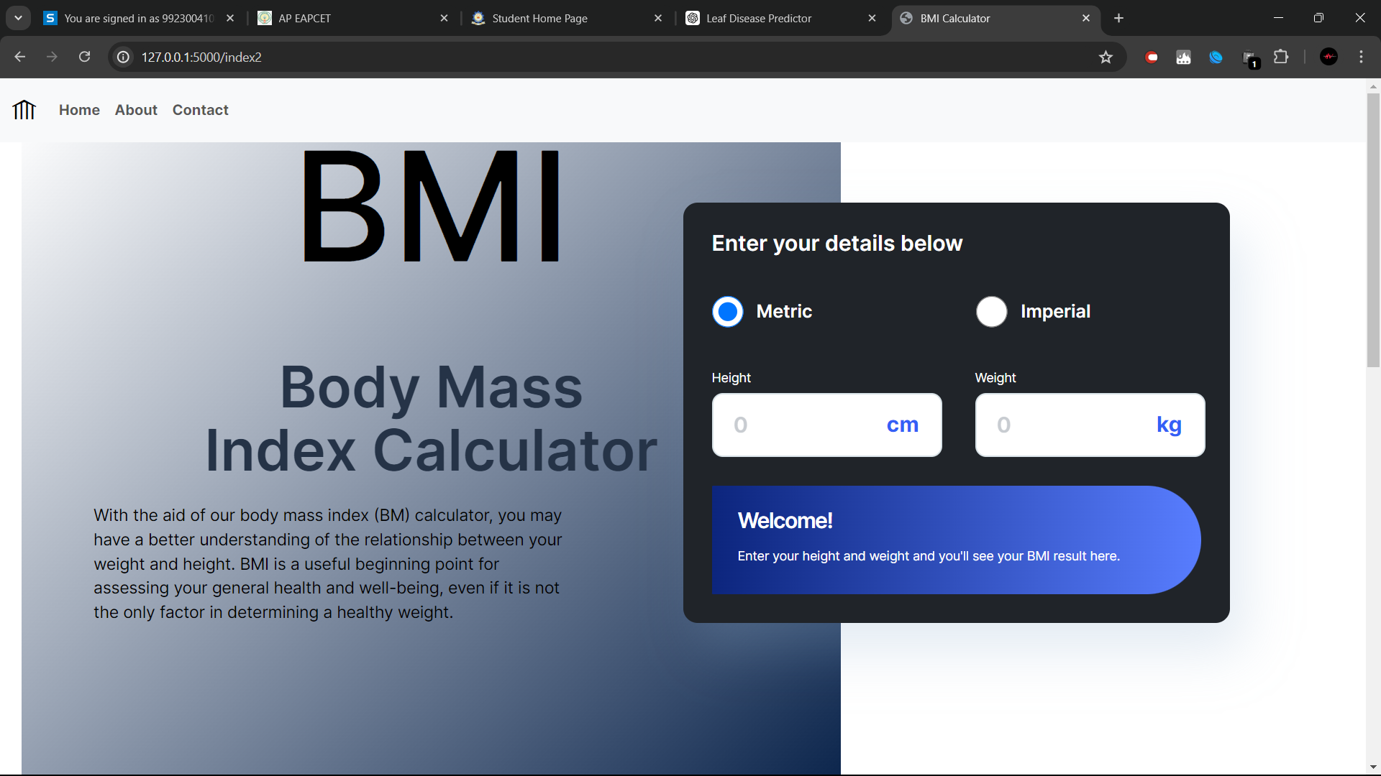

Slide 22
CONCLUSION
Recommending enriched nutrition diets using predictive analytics is a promising approach to improve public health and reduce the economic burden of diet-related diseases.
By leveraging machine learning algorithms, nutrition data, and user input, personalized nutrition recommendations can be generated to meet individual nutritional needs and preferences.
The proposed system design integrates user input, nutrition data, and predictive analytics to provide enriched nutrition diets tailored to individual characteristics and needs.
The system's ability to generate recipes, track progress, and adjust recommendations based on user feedback ensures a user-friendly and effective experience.

Slide 23
REFERENCES
"Nutrition and Dietetics: A Guide for Healthcare Professionals" by S. S. Singh and S. K. Goyal (2019)
"Predictive Analytics: The Power to Predict Who Will Click, Buy, Lie, or Die" by Eric Siegel (2013)
"Machine Learning for Healthcare: Handling Complexity and Improving Outcomes" by S. K. Singh and S. K. Goyal (2020)
"Personalized Nutrition and Lifestyle Recommendations Using Machine Learning" by A. K. Jain et al. (2020) in Journal of Nutrition and Metabolism
"Predictive Modeling of Dietary Patterns and Cardiovascular Disease Risk" by Y. Zhang et al. (2019) in American Journal of Clinical Nutrition
"Machine Learning-Based Dietary Recommendation System for Chronic Disease Prevention" by H. Kim et al. (2019) in Journal of Medical Systems

Slide 24
THANK YOU

